Slide 1




PROJECT
COMPUTER
by Matthew Ukranian

Slide 2


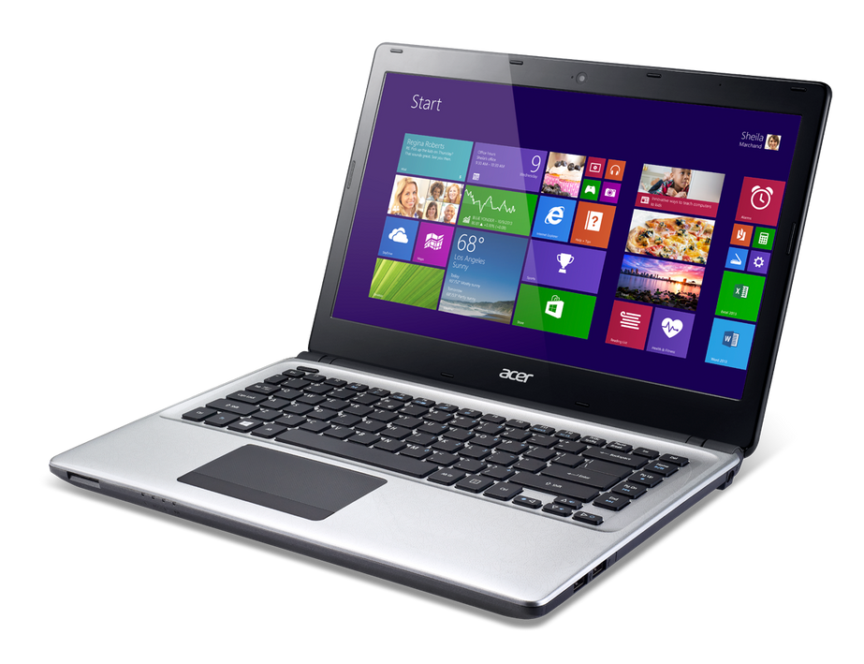
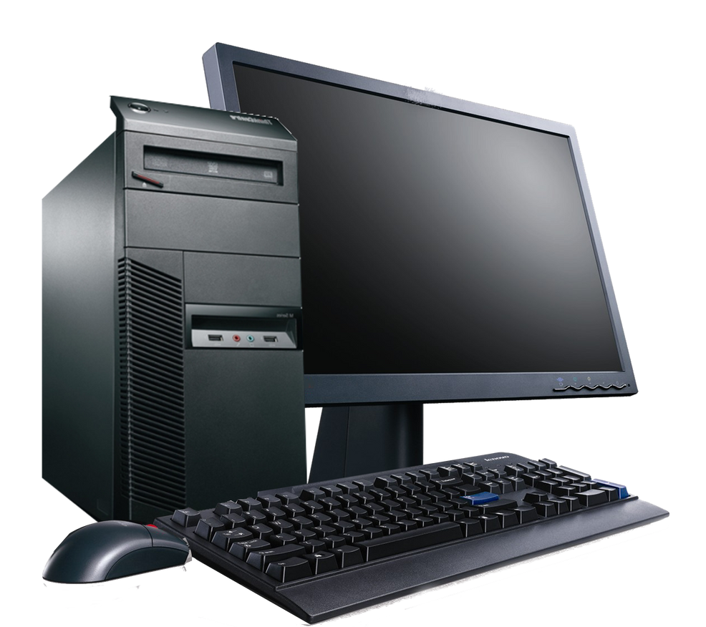

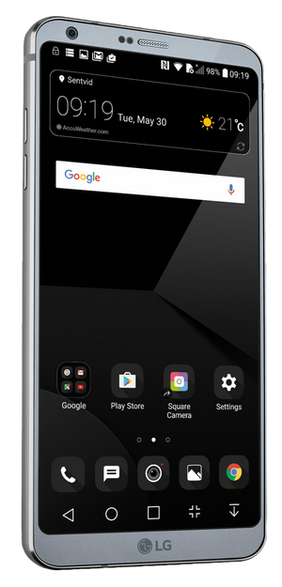
Appearance and Components of a Computer

Slide 3
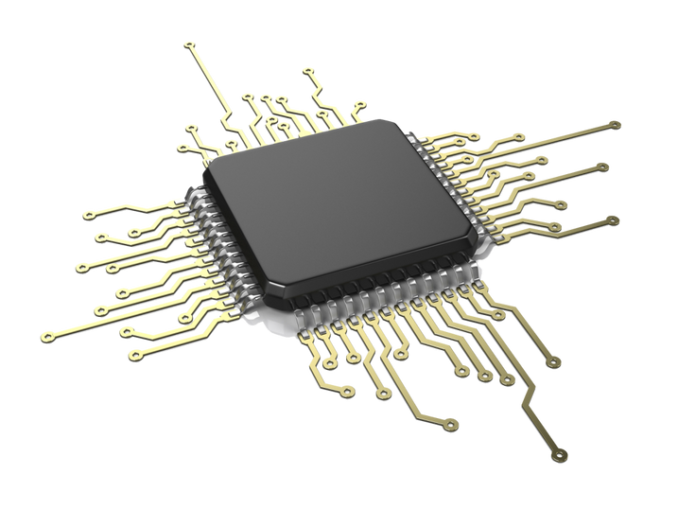
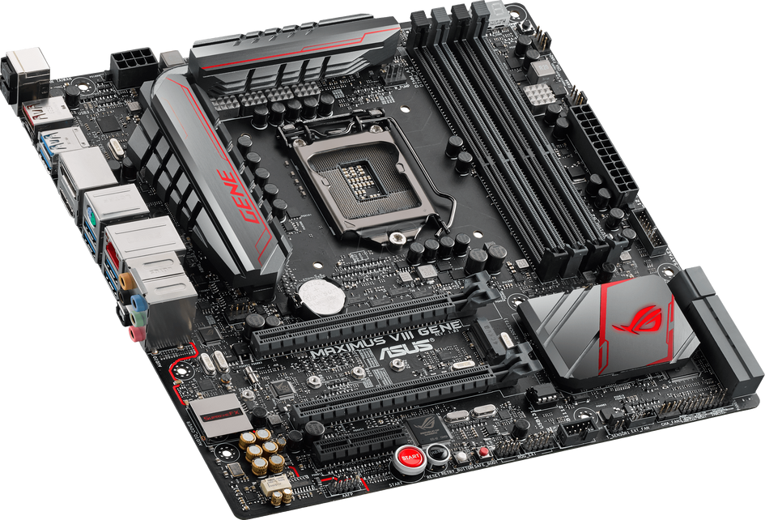
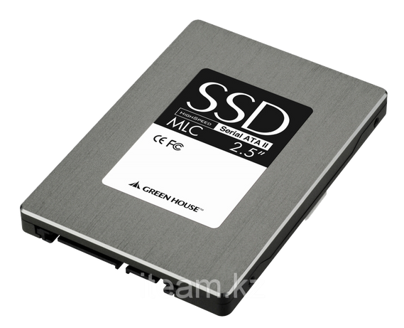
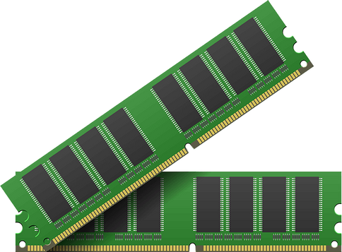
Appearance and Components of a Computer
Central Processing Unit (CPU)
Motherboard
Memory (RAM)
Storage (HDD/SSD)

Slide 4
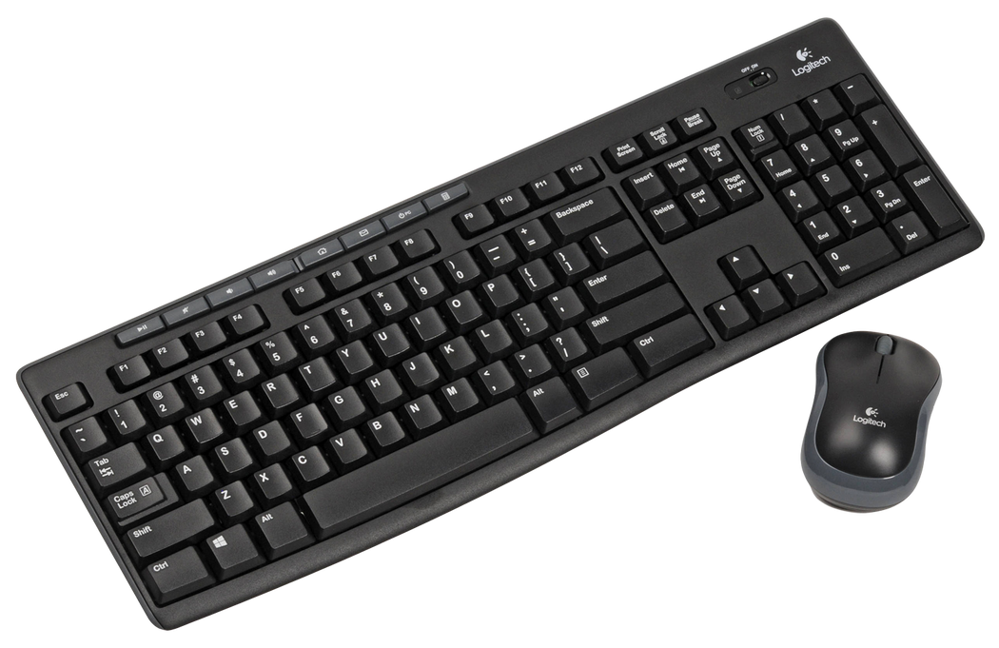
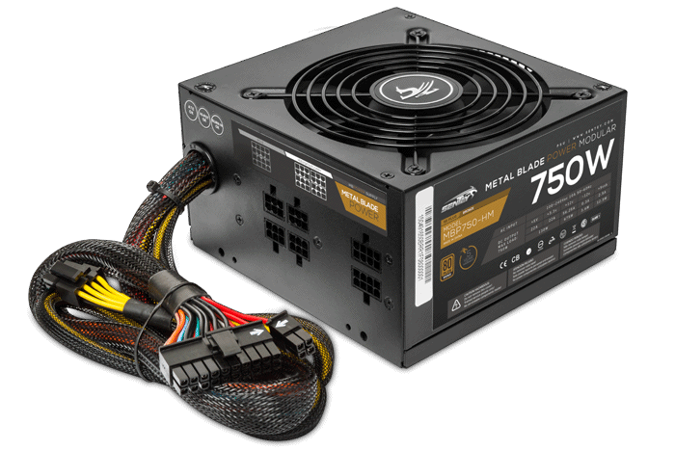
Appearance and Components of a Computer
Input/Output Devices
Power Supply Unit (PSU

Slide 5



Brand Overview
Specializes in innovative consumer electronics and software.
Offers a wide range of computing solutions.
Focuses on business and consumer laptops with high performance.

Slide 6


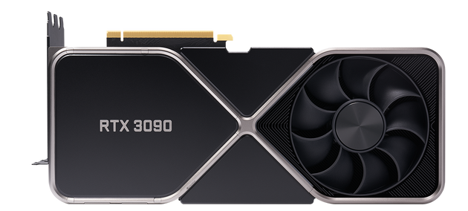
Technical Characteristics
Processor Speed: Measured in GHz, affects how quickly tasks are executed.
• RAM Size: Typically ranges from 4GB to 64GB; impacts multitasking capabilities.
• Storage Capacity: HDDs offer larger storage; SSDs provide faster access times.
• Graphics Card: Determines the quality of visual output, crucial for gaming and design applications.

Slide 7

CAPABILITIES, ADVANTAGES, AND DISADVANTAGES
С
A
D
Data processing and manipulation.
Facilitates electronically mediated communications.
High degree of commonality in components allows for easy upgrades.
Versatile applications across multiple disciplines.
Can be expensive to maintain and upgrade.
Vulnerable to security threats if not properly managed.

Slide 8
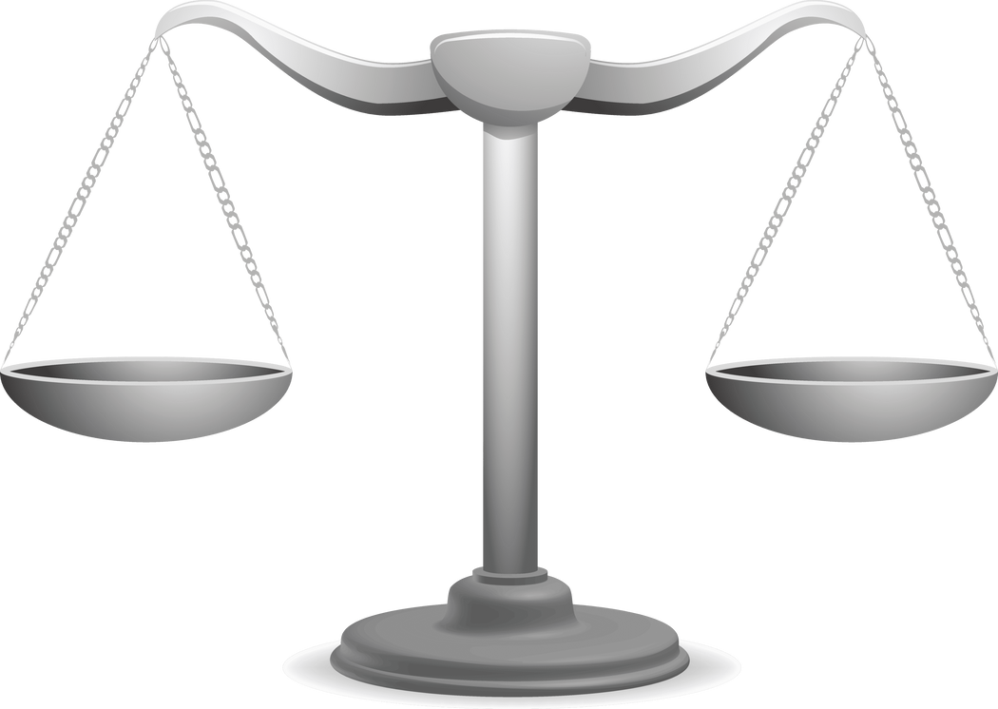

PERSONAL CHOICE
Why People Chose This Computer:
• The balance between performance and user experience makes it suitable for both personal and professional use.
• Its reputation and reviews for reliability alignments with we ned for a dependent girl.

Slide 9
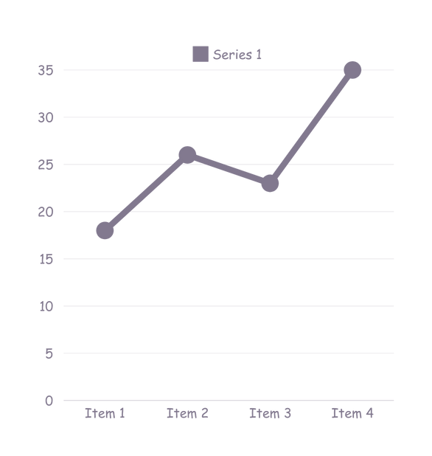

Similar Products for Comparison
• Comparative Products:
• Microsoft Surface: Known for its versatility as a tablet-laptop hybrid.
• Asus ROG Series: Tailored for gaming with high-performance specifications.
• Comparison Factors:
• Price, performance, design, and intended use.

Slide 10


DISCUSSION POINTS
What are your primary needs when selecting a computer?
• How do you perceive the balance between performance and cost?
• What brands do you trust, and why?

Slide 11
THANK YOU
by Matthew Ukranian

